Slide 1
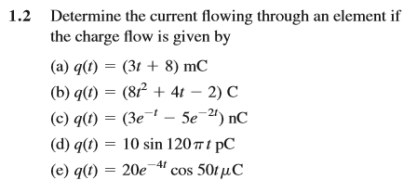
Homework(Second time)
1
Problems 1.2, 1.13, 1.15, 1.18, 1.20

Slide 2
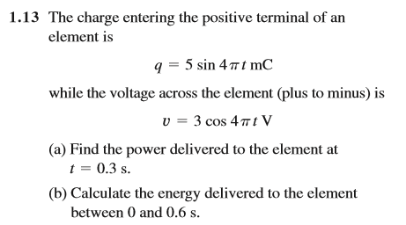
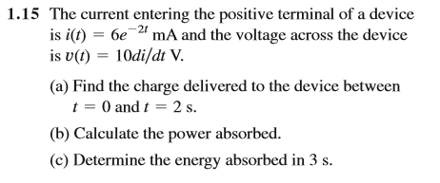

Slide 3
